Slide 1

Discrete Time Dynamical Systems
MTH 564 – Mathematical Modeling

Slide 2

Example: Astronauts
Astronauts in training are required to practice a docking maneuver under manual control. As part of this maneuver, it is required to bring an orbiting spacecraft to rest relative to another orbiting craft. The hand controls provide for variable acceleration and deceleration, and there is a device on board that measures the rate of closing between the two vehicles.

Slide 3
Example: Astronauts
The following strategy has been proposed for bringing the craft to rest. First, look at the closing velocity. If it is zero, we are done. Otherwise, remember the closing velocity and look at the acceleration control. Move the acceleration control so that
it is opposite to the closing velocity. (i.e. if closing velocity is positive, we slow down, and we speed up if it is negative.)
move it proportional in magnitude. (i.e. brake twice as hard if we find ourselves closing twice as fast)
After a time, look at the closing velocity again and repeat the procedure. Under what circumstances will this strategy be effective?
Assumptions: We now assume that it takes 5 seconds to make the control adjustments and another 10 seconds until the astronaut can return from other tasks to observe the velocity indicator once again. Under these conditions, will our strategies for matching velocities be successful?

Slide 4
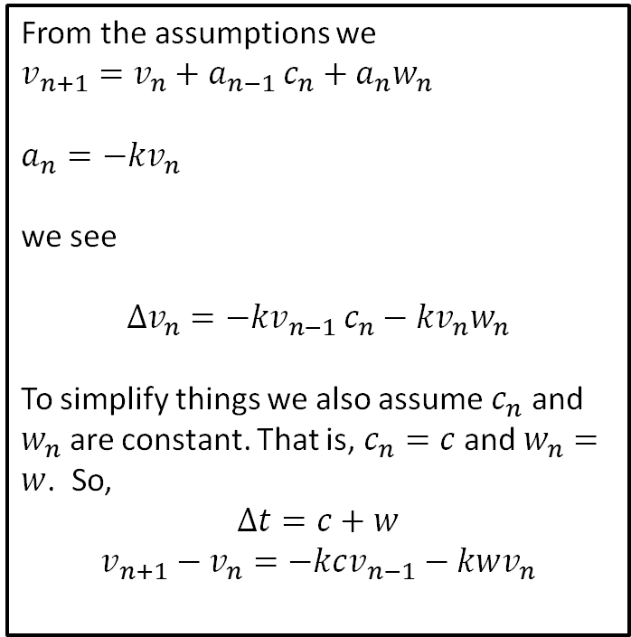

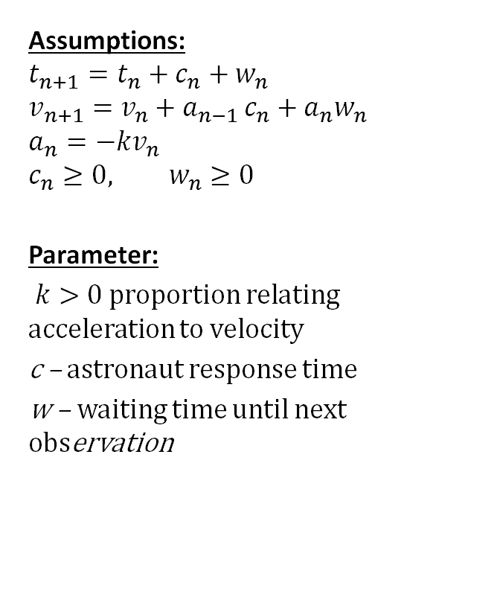
Step 1: Ask the question (Previous)
Assumptions:
$$t_{n+1}=t_{n}+c_{n}+w_{n}$$
$$v_{n+1}=v_{n}+a_{n−1 }c_{n}+a_{n}w_{n}$$
$$a_{n}=−kv_{n}$$
$$c_{n}≥0, w_{n}≥0$$
Parameter:
$k>0$ proportion relating acceleration to velocity
c – astronaut response time
w – waiting time until next observation
From the assumptions we
$$v_{n+1}=v_{n}+a_{n−1 }c_{n}+a_{n}w_{n}$$
$$a_{n}=−kv_{n}$$
we see
$$Δv_{n}={−kv}_{n−1 }c_{n}−kv_{n}w_{n}$$
To simplify things we also assume $c_{n}$ and
$w_{n}$ are constant. That is, $c_{n}=c$ and $w_{n}=w$. So,
$$Δt=c+w$$
$$v_{n+1}−v_{n}=−kcv_{n−1}−kwv_{n}$$
Objective
Determine whether $v_{n}→0$.

Slide 5
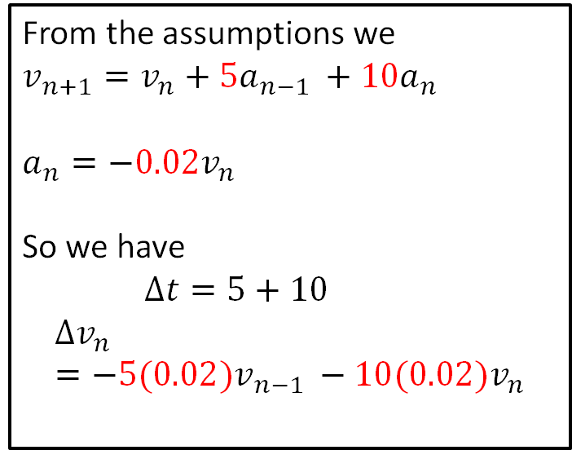

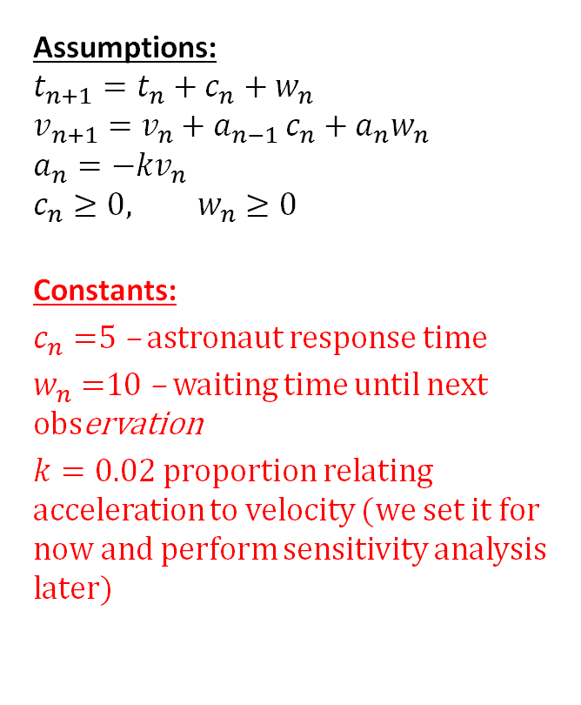
Step 1: Ask the question (Now)
Assumptions:
$$t_{n+1}=t_{n}+c_{n}+w_{n}$$
$$v_{n+1}=v_{n}+a_{n−1 }c_{n}+a_{n}w_{n}$$
$$a_{n}=−kv_{n}$$
$$c_{n}≥0, w_{n}≥0$$
Constants:
$c_{n}=$5 – astronaut response time
$w_{n}=$10 – waiting time until next observation
$k=0.02$ proportion relating acceleration to velocity (we set it for now and perform sensitivity analysis later)
From the assumptions we
$$v_{n+1}=v_{n}+{5a}_{n−1 }+{10a}_{n}$$
$$a_{n}=−0.02v_{n}$$
So we have
$Δt=5+10$
$$Δv_{n}={−5(0.02)v}_{n−1 }−10(0.02)v_{n}$$
Objective
Determine whether $v_{n}→0$.

Slide 6

Step 2: Select the modeling approach
Assumptions:
$$t_{n+1}=t_{n}+c_{n}+w_{n}$$
$$v_{n+1}=v_{n}+a_{n−1 }c_{n}+a_{n}w_{n}$$
$$a_{n}=−kv_{n}$$
$$c_{n}≥0, w_{n}≥0$$
Constants:
$c_{n}=$5 – astronaut response time
$w_{n}=$10 – waiting time until next observation
$k=0.02$ proportion relating acceleration to velocity (we set it for now and perform sensitivity analysis later)
From the assumptions we
$$v_{n+1}=v_{n}+{5a}_{n−1 }+{10a}_{n}$$
$$a_{n}=−0.02v_{n}$$
So we have
$Δt=5+10$
$$Δv_{n}={−5(0.02)v}_{n−1 }−10(0.02)v_{n}$$
We model this as a discrete time dynamical system and use an eigenvalue method.
Objective
Determine whether $v_{n}→0$.

Slide 7
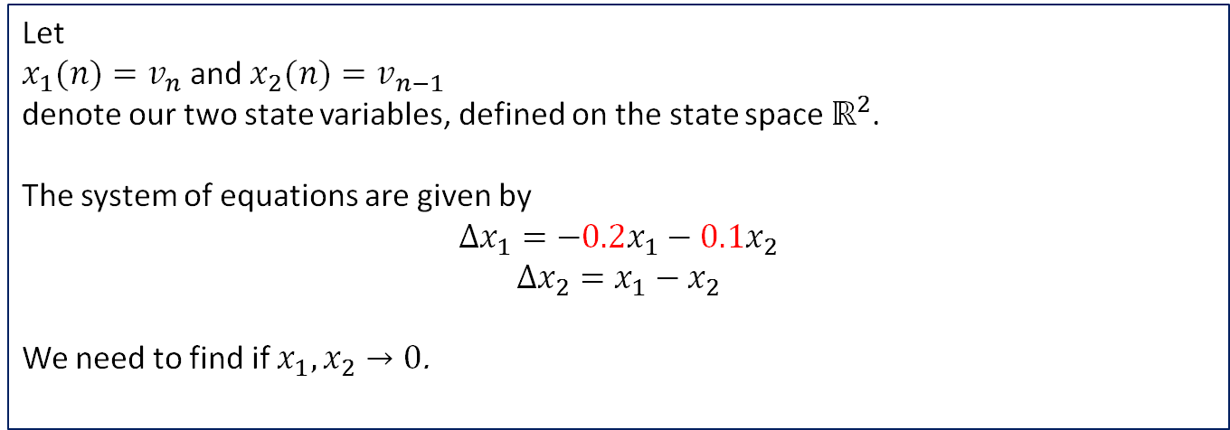
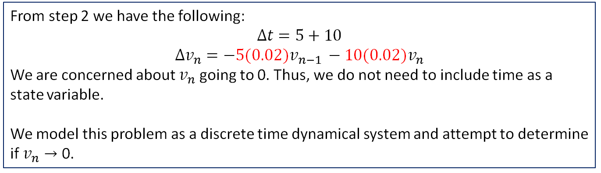
Step 3: Formulate the model
From step 2 we have the following:
$$Δt=5+10$$
$$Δv_{n}={−5(0.02)v}_{n−1 }−10(0.02)v_{n}$$
We are concerned about $v_{n}$ going to 0. Thus, we do not need to include time as a state variable.
We model this problem as a discrete time dynamical system and attempt to determine if $v_{n}→$ 0.
Let
$x_{1}(n)=v_{n}$ and $x_{2}(n)=v_{n−1}$
denote our two state variables, defined on the state space $ℝ^{2}$.
The system of equations are given by
$$Δx_{1}=−0.2x_{1}−0.1x_{2}$$
$$Δx_{2}=x_{1}−x_{2}$$
We need to find if $x_{1},x_{2}→0$.

Slide 8
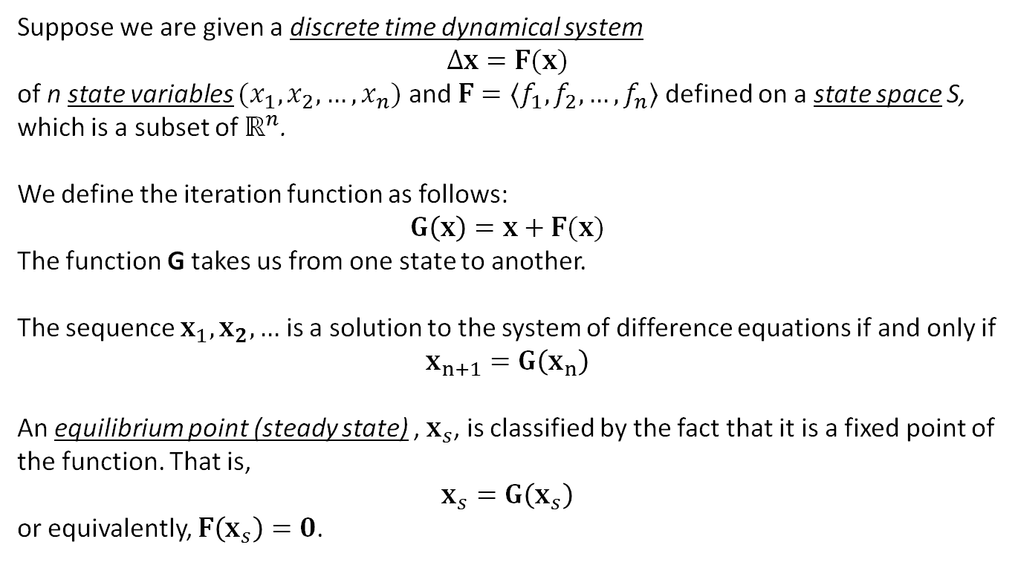
Discrete Time Dynamic Systems
Suppose we are given a discrete time dynamical system
$$Δx=F(x)$$
of n state variables $(x_{1},x_{2},…,x_{n})$ and $F=〈f_{1},f_{2}, …, f_{n}〉$ defined on a state space S, which is a subset of $ℝ^{n}$.
We define the iteration function as follows:
$$G\left(x\right)=x+F(x)$$
The function G takes us from one state to another.
The sequence $x_{1},x_{2},…$ is a solution to the system of difference equations if and only if
$$x_{n+1}=G\left(x_{n}\right)$$
An equilibrium point (steady state) , $x_{s}$, is classified by the fact that it is a fixed point of the function. That is,
$$x_{s}=G\left(x_{s}\right)$$
or equivalently, $F\left(x_{s}\right)=0$.

Slide 9
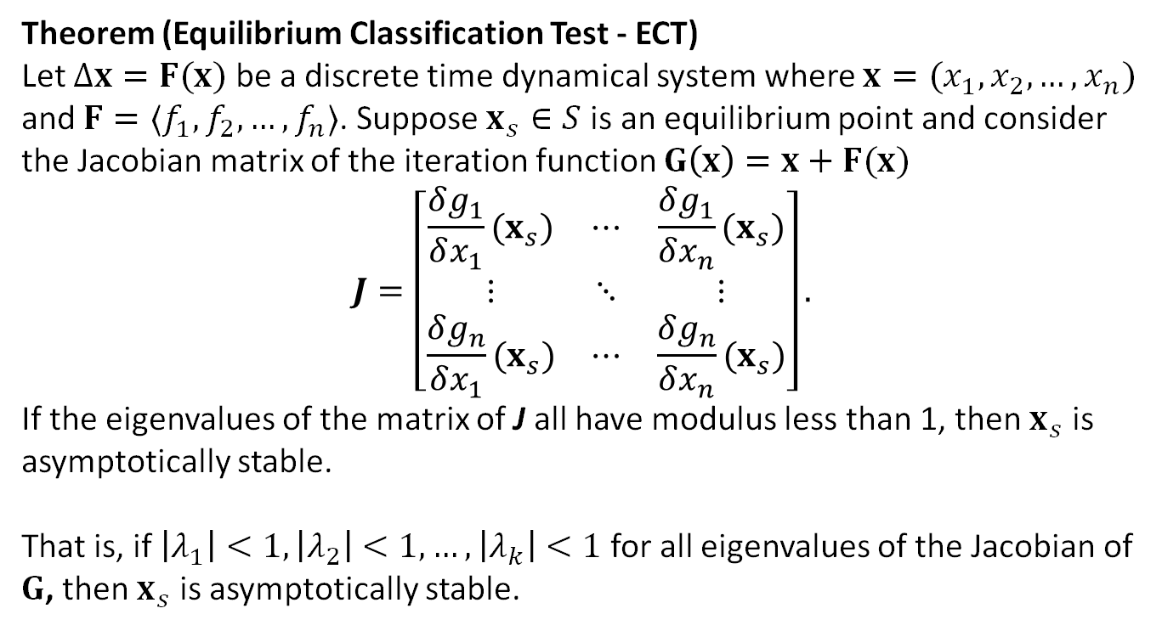
Dynamic Systems: ECT
Theorem (Equilibrium Classification Test - ECT)
Let $Δx=F(x)$ be a discrete time dynamical system where $x=(x_{1},x_{2},…,x_{n})$ and $F=〈f_{1},f_{2}, …, f_{n}〉$. Suppose$x_{s}∈S$ is an equilibrium point and consider the Jacobian matrix of the iteration function $G\left(x\right)=x+F(x)$
$$J=\left[\begin{matrix}\frac{δg_{1}}{δx_{1}}(x_{s}) & ⋯ & \frac{δg_{1}}{δx_{n}}(x_{s}) \\ ⋮ & ⋱ & ⋮ \\ \frac{δg_{n}}{δx_{1}}(x_{s}) & ⋯ & \frac{δg_{n}}{δx_{n}}(x_{s})\end{matrix}\right].$$
If the eigenvalues of the matrix of J all have modulus less than 1, then$x_{s}$ is asymptotically stable.
That is, if $\left|λ_{1}\right|<1,\left|λ_{2}\right|<1, …,\left|λ_{k}\right|<1$for all eigenvalues of the Jacobian of $G$, then$x_{s}$ is asymptotically stable.

Slide 10

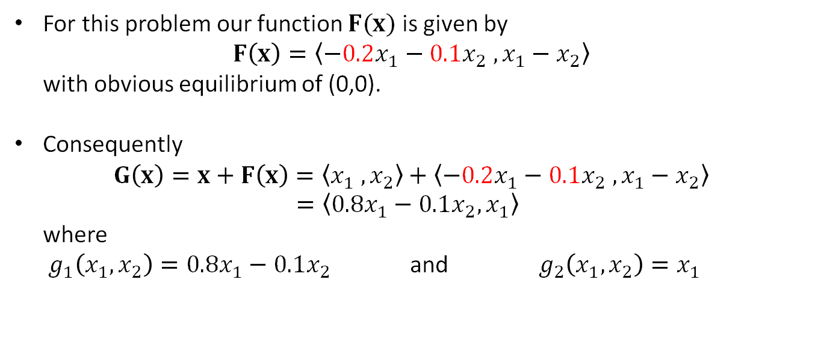
Step 4: Solve the Problem
We are studying the following dynamical system on the state space $ℝ^{2}$.
$$Δx_{1}=−0.2x_{1}−0.1x_{2}$$
$$Δx_{2}=x_{1}−x_{2}$$
For this problem our function $F(x)$ is given by $F\left(x\right)=〈−0.2x_{1}−0.1x_{2} ,x_{1}−x_{2}〉$ with obvious equilibrium of (0,0).
Consequently $G\left(x\right)=x+F\left(x\right)=〈x_{1} , x_{2}〉+〈−0.2x_{1}−0.1x_{2} ,x_{1}−x_{2}〉$ $=〈0.8x_{1}−0.1x_{2},x_{1}〉$ where $g_{1}\left(x_{1},x_{2}\right)=0.8x_{1}−0.1x_{2}$ and $g_{2}\left(x_{1},x_{2}\right)=x_{1}$

Slide 11
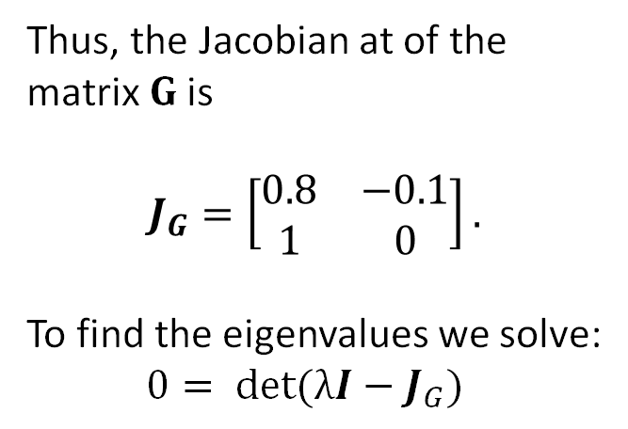
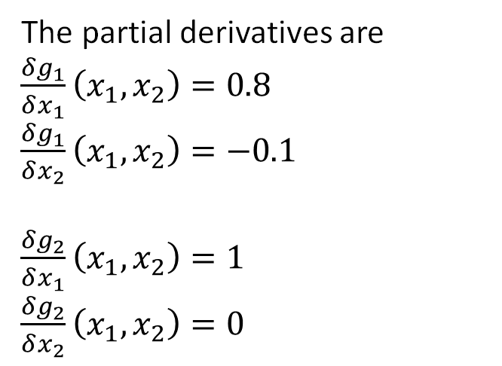
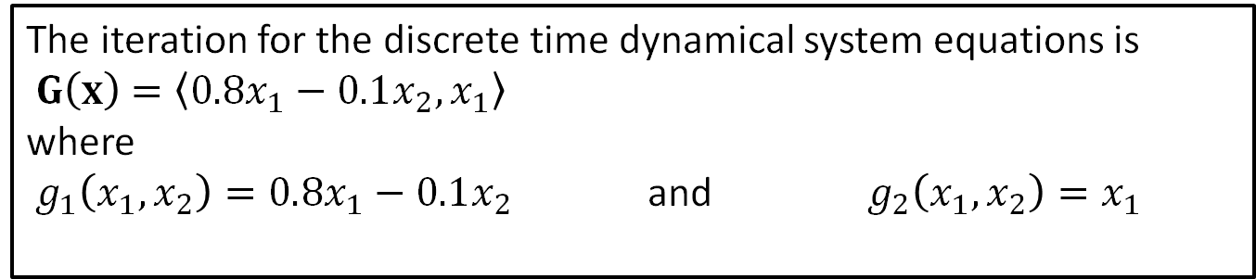
Step 4: Solve the Problem
The iteration for the discrete time dynamical system equations is
$G\left(x\right)$ $=〈0.8x_{1}−0.1x_{2},x_{1}〉$ where $g_{1}\left(x_{1},x_{2}\right)=0.8x_{1}−0.1x_{2}$ and $g_{2}\left(x_{1},x_{2}\right)=x_{1}$
The partial derivatives are
$\frac{δg_{1}}{δx_{1}}\left(x_{1}, x_{2}\right)=0.8$
$\frac{δg_{1}}{δx_{2}}\left(x_{1}, x_{2}\right)=−0.1$
$\frac{δg_{2}}{δx_{1}}\left(x_{1}, x_{2}\right)=1$
$\frac{δg_{2}}{δx_{2}}\left(x_{1}, x_{2}\right)=0$
Thus, the Jacobian at of the matrix $G$ is
$$J_{G}=\left[\begin{matrix}0.8 & −0.1 \\ 1 & 0\end{matrix}\right].$$
To find the eigenvalues we solve:
$$0= det(λI−J_{G})$$

Slide 12
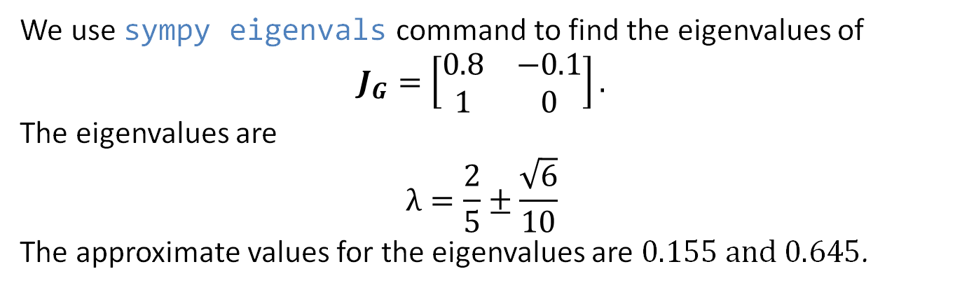
Step 4: Solve the Problem
The iteration for the discrete time dynamical system equations is
$G\left(x\right)$ $=〈0.8x_{1}−0.1x_{2},x_{1}〉$ where $g_{1}\left(x_{1},x_{2}\right)=0.8x_{1}−0.1x_{2}$ and $g_{2}\left(x_{1},x_{2}\right)=x_{1}$
We use sympy eigenvals command to find the eigenvalues of
$$J_{G}=\left[\begin{matrix}0.8 & −0.1 \\ 1 & 0\end{matrix}\right].$$
The eigenvalues are
$$λ=\frac{2}{5}±\frac{\sqrt{6}}{10}$$
The approximate values for the eigenvalues are $0.155 and 0.645$.

Slide 13
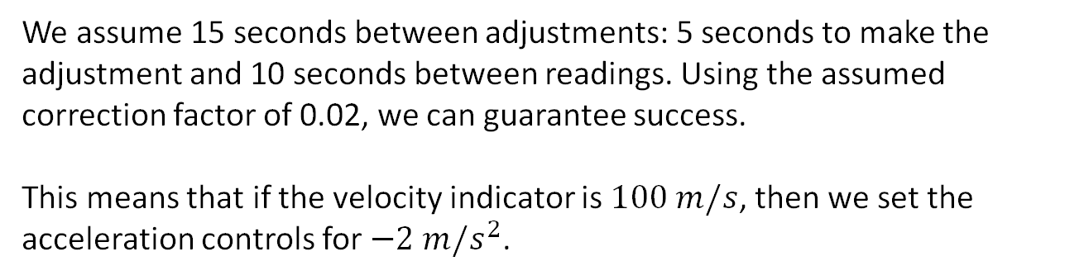
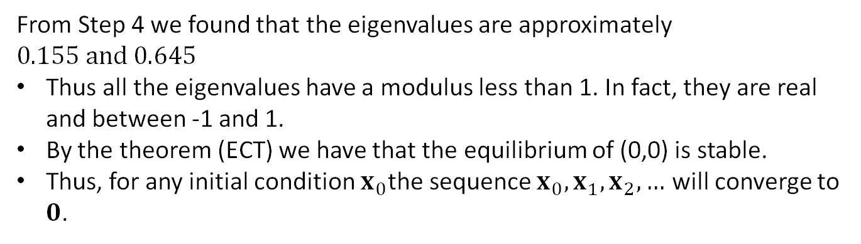
Step 5: Answer the question
From Step 4 we found that the eigenvalues are approximately $0.155 and 0.645$
Thus all the eigenvalues have a modulus less than 1. In fact, they are real and between -1 and 1.
By the theorem (ECT) we have that the equilibrium of (0,0) is stable.
Thus, for any initial condition $x_{0}$the sequence $x_{0},x_{1},x_{2}, …$ will converge to $0$.
We assume 15 seconds between adjustments: 5 seconds to make the adjustment and 10 seconds between readings. Using the assumed correction factor of 0.02, we can guarantee success.
This means that if the velocity indicator is $100 m/s$, then we set the acceleration controls for $−2 m/s^{2}$.

Slide 14
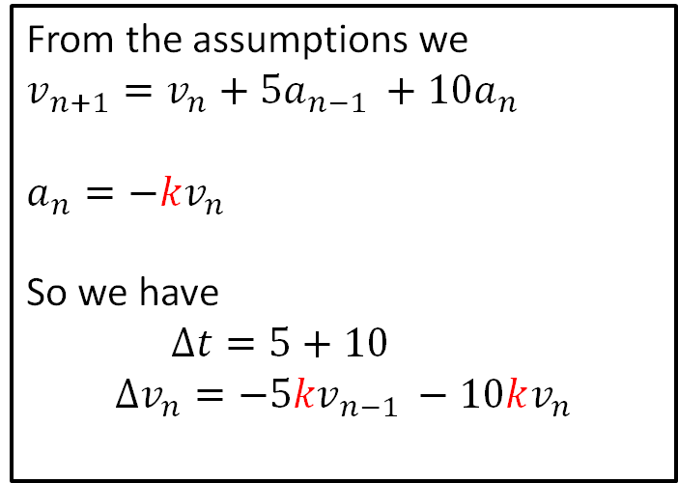
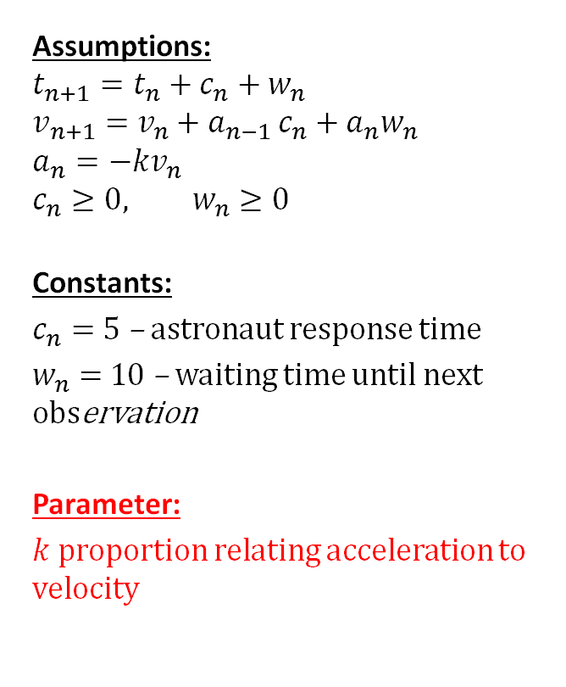
Sensitivity Analysis
Assumptions:
$$t_{n+1}=t_{n}+c_{n}+w_{n}$$
$$v_{n+1}=v_{n}+a_{n−1 }c_{n}+a_{n}w_{n}$$
$$a_{n}=−kv_{n}$$
$$c_{n}≥0, w_{n}≥0$$
Constants:
$c_{n}=$ 5 – astronaut response time
$w_{n}=$ 10 – waiting time until next observation
Parameter:
$k$ proportion relating acceleration to velocity
From the assumptions we
$$v_{n+1}=v_{n}+{5a}_{n−1 }+{10a}_{n}$$
$$a_{n}=−kv_{n}$$
So we have
$Δt=5+10$
$$Δv_{n}={−5kv}_{n−1 }−10kv_{n}$$
Objective
Determine whether $v_{n}→0$.

Slide 15
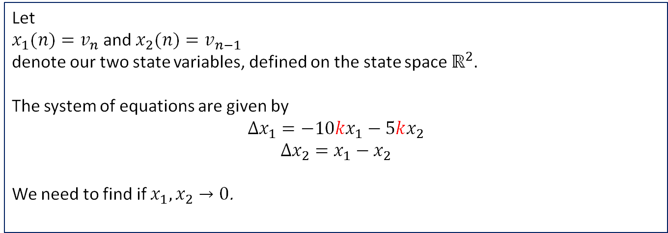
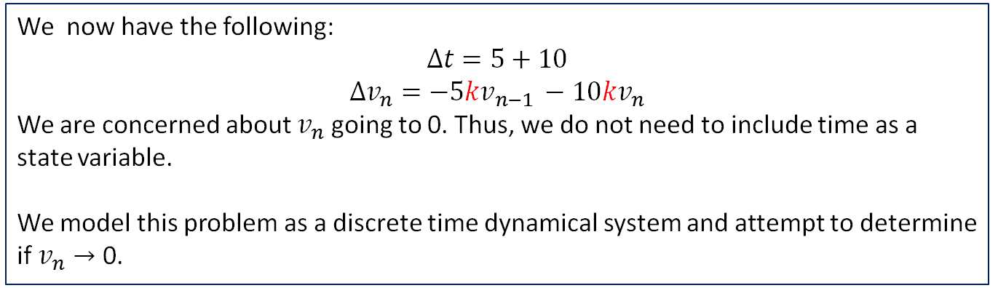
Sensitivity Analysis
We now have the following:
$$Δt=5+10$$
$$Δv_{n}={−5kv}_{n−1 }−10kv_{n}$$
We are concerned about $v_{n}$ going to 0. Thus, we do not need to include time as a state variable.
We model this problem as a discrete time dynamical system and attempt to determine if $v_{n}→$ 0.
Let
$x_{1}(n)=v_{n}$ and $x_{2}(n)=v_{n−1}$
denote our two state variables, defined on the state space $ℝ^{2}$.
The system of equations are given by
$$Δx_{1}=−10kx_{1}−5kx_{2}$$
$$Δx_{2}=x_{1}−x_{2}$$
We need to find if $x_{1},x_{2}→0$.

Slide 16

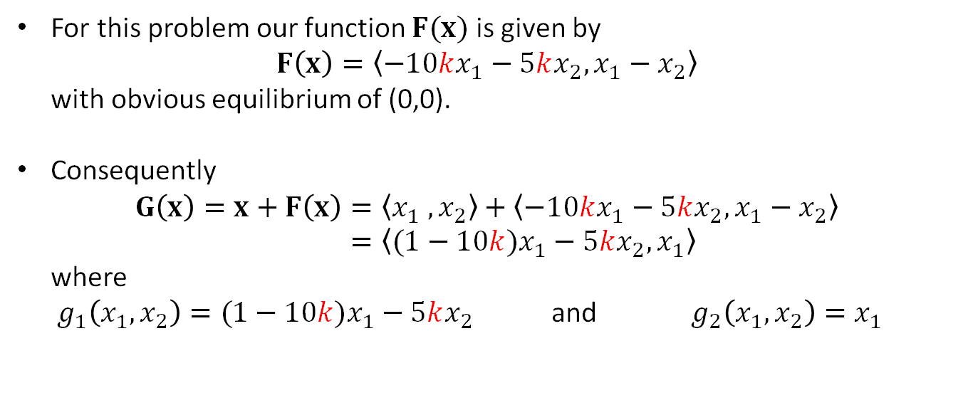
Sensitivity Analysis: Iteration Function
We are studying the following dynamical system on the state space$ℝ^{2}$.
$$Δx_{1}=−10kx_{1}−5kx_{2}$$
$$Δx_{2}=x_{1}−x_{2}$$
For this problem our function $F(x)$ is given by $F\left(x\right)=〈−10kx_{1}−5kx_{2},x_{1}−x_{2}〉$ with obvious equilibrium of (0,0).
Consequently $G\left(x\right)=x+F\left(x\right)=〈x_{1} , x_{2}〉+〈−10kx_{1}−5kx_{2},x_{1}−x_{2}〉$ $=〈(1−10k)x_{1}−5kx_{2},x_{1}〉$ where $g_{1}\left(x_{1},x_{2}\right)=(1−10k)x_{1}−5kx_{2}$ and $g_{2}\left(x_{1},x_{2}\right)=x_{1}$

Slide 17
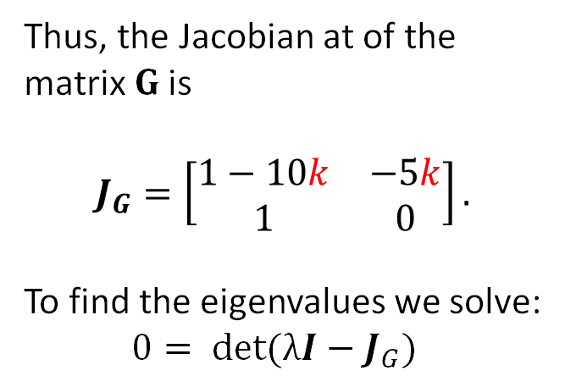
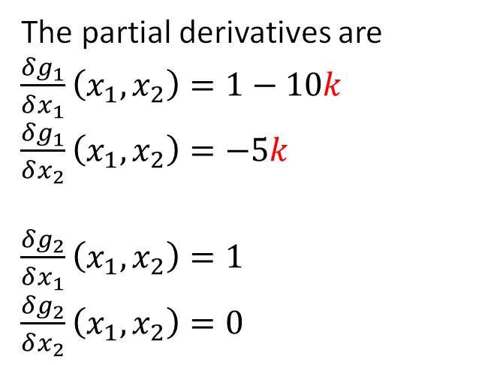
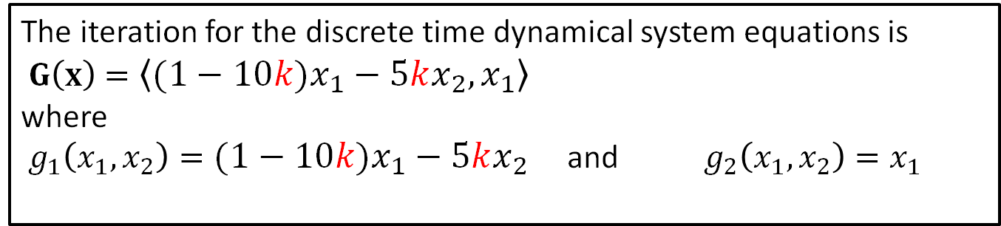
Sensitivity Analysis: Jacobian
The iteration for the discrete time dynamical system equations is
$G\left(x\right)$ $=〈(1−10k)x_{1}−5kx_{2},x_{1}〉$ where $g_{1}\left(x_{1},x_{2}\right)=(1−10k)x_{1}−5kx_{2}$ and $g_{2}\left(x_{1},x_{2}\right)=x_{1}$
The partial derivatives are
$\frac{δg_{1}}{δx_{1}}\left(x_{1}, x_{2}\right)=1−10k$
$\frac{δg_{1}}{δx_{2}}\left(x_{1}, x_{2}\right)=−5k$
$\frac{δg_{2}}{δx_{1}}\left(x_{1}, x_{2}\right)=1$
$\frac{δg_{2}}{δx_{2}}\left(x_{1}, x_{2}\right)=0$
Thus, the Jacobian at of the matrix $G$ is
$$J_{G}=\left[\begin{matrix}1−10k & −5k \\ 1 & 0\end{matrix}\right].$$
To find the eigenvalues we solve:
$$0= det(λI−J_{G})$$

Slide 18


Sensitivity Analysis: Eigenvalues
From the Jacobian
$$J_{G}=\left[\begin{matrix}1−10k & −5k \\ 1 & 0\end{matrix}\right].$$
we use sympy eigenvals command to find the eigenvalues of
The eigenvalues are
$$λ_{1}, λ_{2}=−5k+ \frac{1}{2}±\frac{\sqrt{100k^{2}−40k+1}}{2}$$

Slide 19
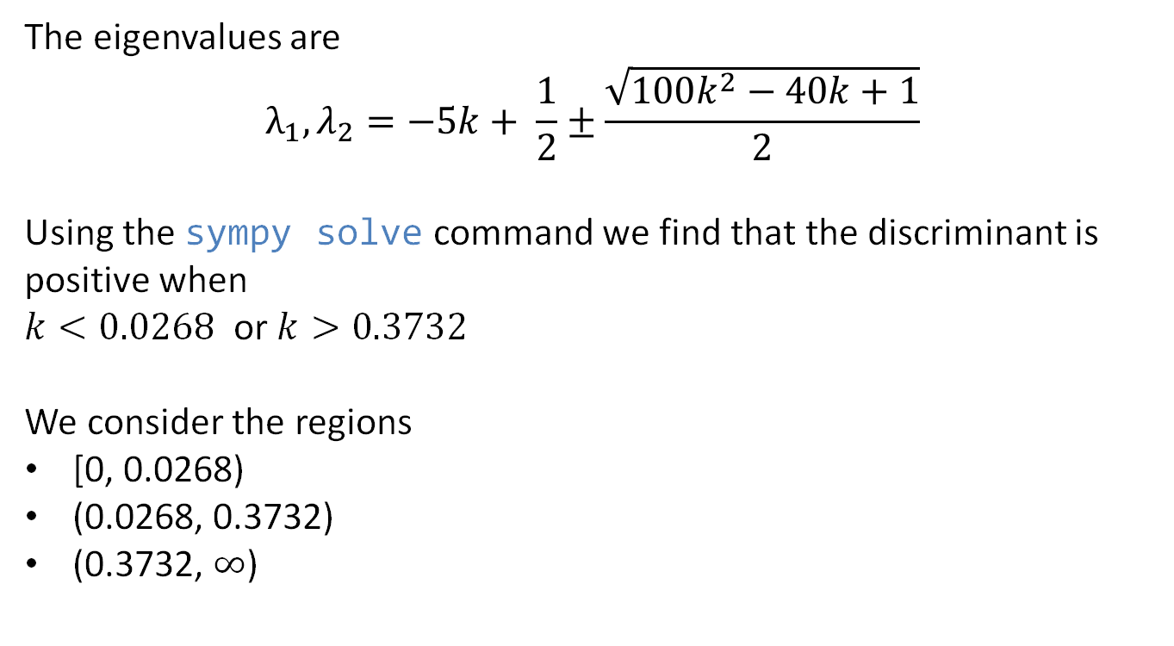
Sensitivity Analysis: Eigenvalues
The eigenvalues are
$$λ_{1}, λ_{2}=−5k+ \frac{1}{2}±\frac{\sqrt{100k^{2}−40k+1}}{2}$$
Using the sympy solve command we find that the discriminant is positive when
$k<0.0268$ or $k>0.3732$
We consider the regions
[0, 0.0268)
(0.0268, 0.3732)
(0.3732, $∞$)

Slide 20
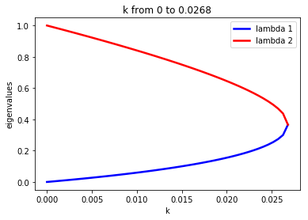
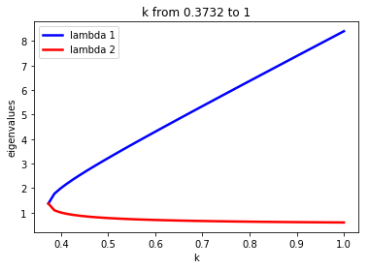
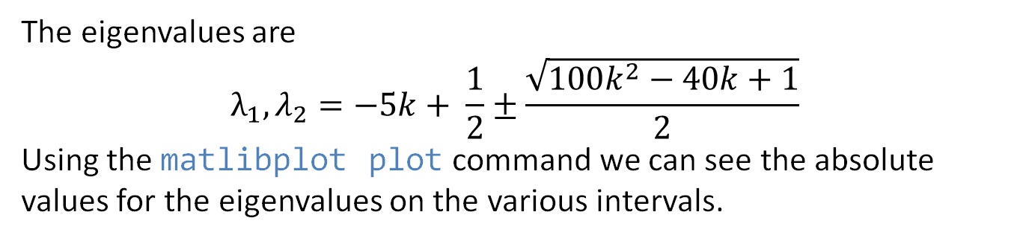
Sensitivity Analysis: Eigenvalues
Note on the interval [0, 0.0268) the absolute value of the eigenvalues is less than 1. The equilibrium is asymptotically stable.
On the interval from [0.3732, 1) the absolute value of the eigenvalues is greater than 1. The equilibrium is NOT asymptotically stable.
The eigenvalues are
$$λ_{1}, λ_{2}=−5k+ \frac{1}{2}±\frac{\sqrt{100k^{2}−40k+1}}{2}$$
Using the matlibplot plot command we can see the absolute values for the eigenvalues on the various intervals.

Slide 21
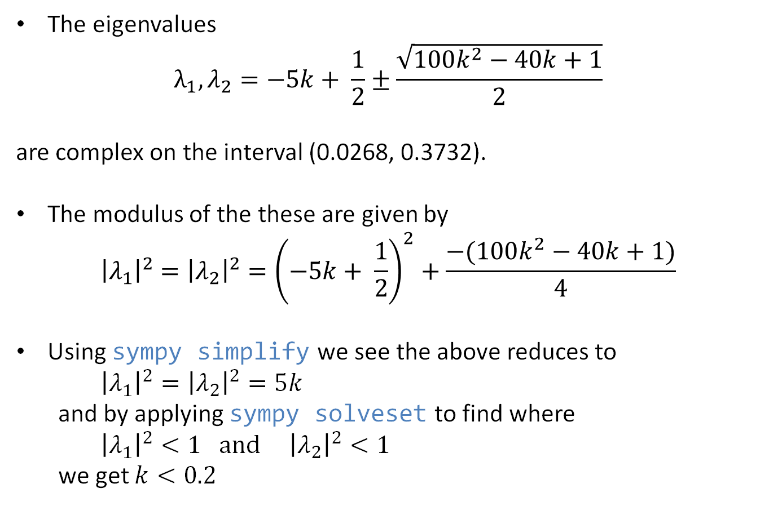
Sensitivity Analysis: Eigenvalues
The eigenvalues
$$λ_{1}, λ_{2}=−5k+ \frac{1}{2}±\frac{\sqrt{100k^{2}−40k+1}}{2}$$
are complex on the interval (0.0268, 0.3732).
The modulus of the these are given by
$${\left|λ_{1}\right|}^{2}={\left|λ_{2}\right|}^{2}={\left(−5k+ \frac{1}{2}\right)}^{2}+\frac{−(100k^{2}−40k+1)}{4}$$
Using sympy simplify we see the above reduces to
${\left|λ_{1}\right|}^{2}={\left|λ_{2}\right|}^{2}=5k$ and by applying sympy solveset to find where
${\left|λ_{1}\right|}^{2}<1 and{ \left|λ_{2}\right|}^{2}<1$
we get $k<0.2$
Notes:
Note the – in front of $(100k^{2}−40k+1)$ is since we are in the complex case and thus the discriminate is negative….the extra – makes it positive

Slide 22
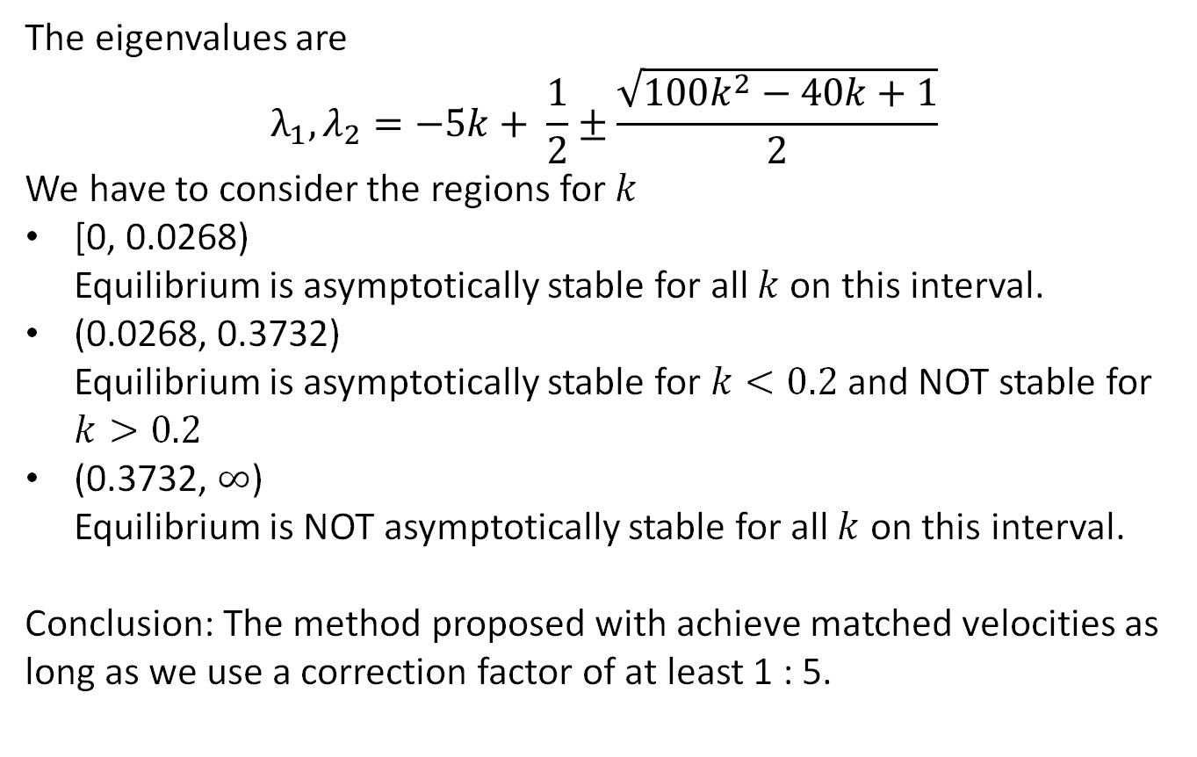
Sensitivity Analysis: Conclusion
The eigenvalues are
$$λ_{1}, λ_{2}=−5k+ \frac{1}{2}±\frac{\sqrt{100k^{2}−40k+1}}{2}$$
We have to consider the regions for $k$
[0, 0.0268) Equilibrium is asymptotically stable for all $k$ on this interval.
(0.0268, 0.3732) Equilibrium is asymptotically stable for $k<0.2$ and NOT stable for $k>0.2$
(0.3732, $∞$) Equilibrium is NOT asymptotically stable for all $k$ on this interval.
Conclusion: The method proposed with achieve matched velocities as long as we use a correction factor of at least 1 : 5.

